Slide 1
FACE DETECTION DRONE
For future security
K.PAVAN KARTHEEK
PAVAN SAI NAGENDRA

Slide 2
Introduction
Drone stand for “Dynamic Remotely Operated Navigation Equipment”.
An unmanned aerial vehicle (UAV) (commonly known as a drone) is an aircraft without a human pilot on board and a type of unmanned vehicle.
The flight of UAVs may operate with various degrees of autonomy: either under remote control by a human operator or autonomously by onboard computers.
The earliest recorded use of UAV is July 1849.
The first large-scale production, purpose-built drone was the product of Reginald Denny.

Slide 3
Quadcopter
A quadcopter, also called a quadrotor helicopter or quadrotor, is a multirotor helicopter that is lifted and propelled by four rotors.
Quadcopters are classified as rotorcraft, as opposed to fixed-wing aircraft, because their lift is generated by a set of rotors (vertically oriented propellers).
By changing the speed of each rotor it is possible to specifically generate a desired total thrust; to locate for the centre of thrust both laterally and longitudinally; and to create a desired total torque, or turning force.

Slide 4
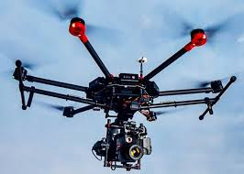
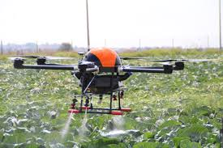
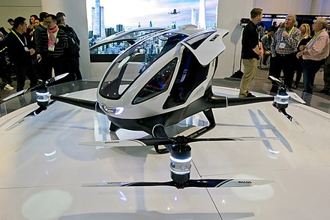
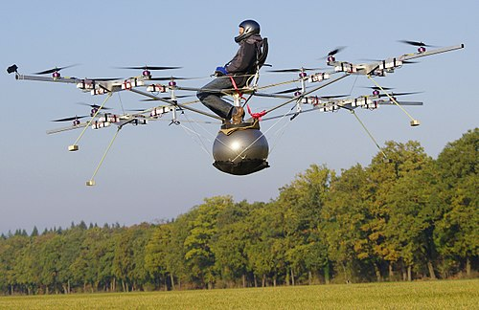
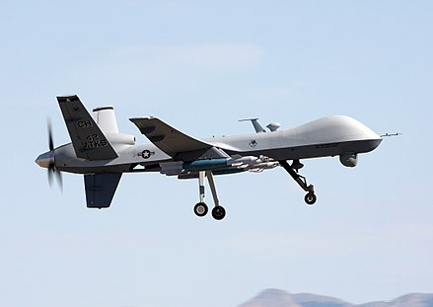
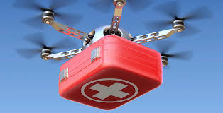
SECTORS IN WHICH DRONE IS USED
Movie
Passenger Drone
Agriculture
Multirotor
Army
Medical

Slide 5
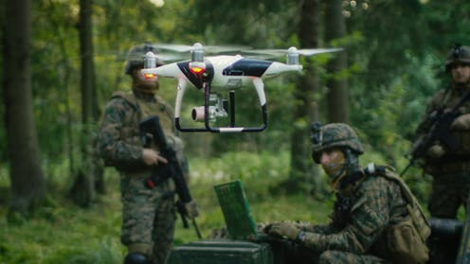
SECURITY RELATED DRONE

Slide 6
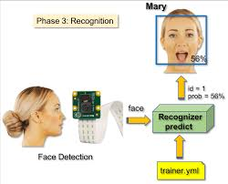
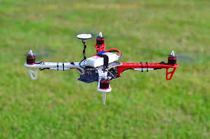
Face detection
Auto pilot

Slide 7
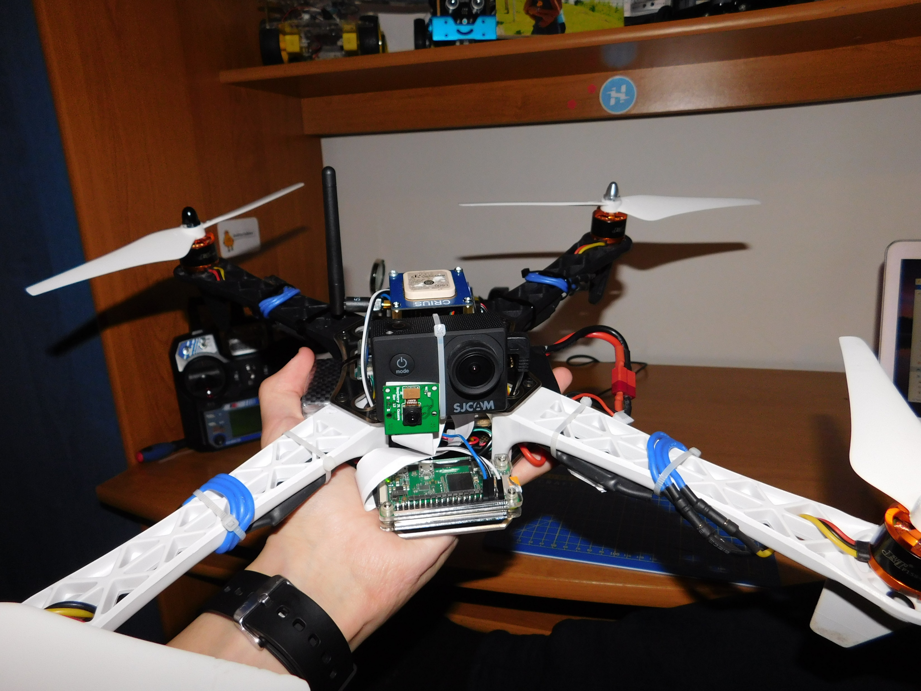
Final design

Slide 8
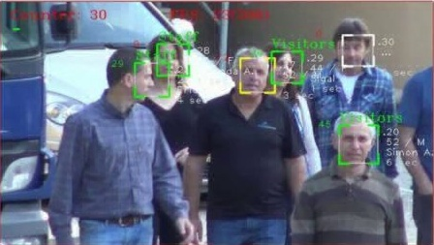
Applications
Security
Attacking
Tracking
Traffic analysis etc.

Slide 9
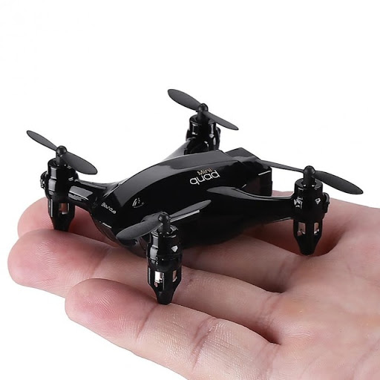
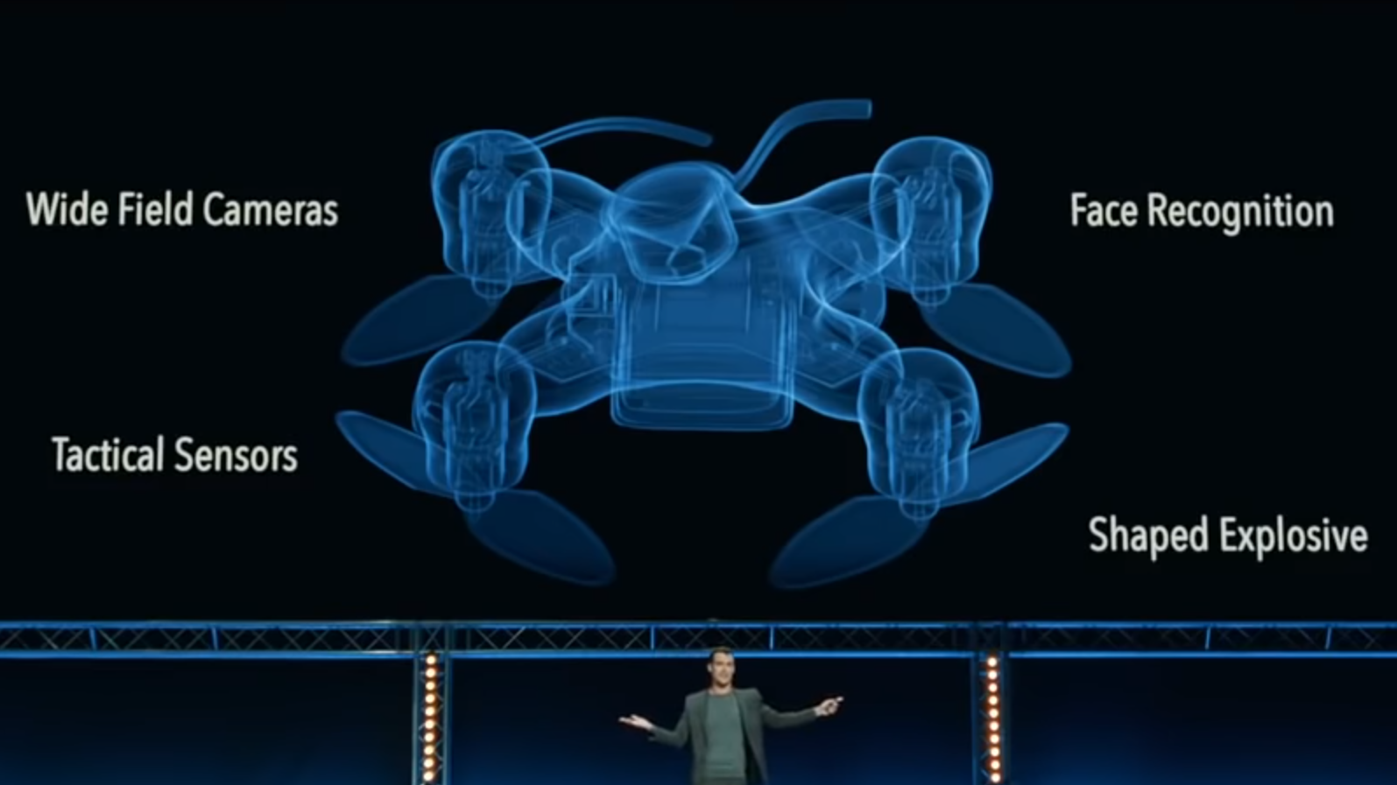
Nano technology

Slide 10
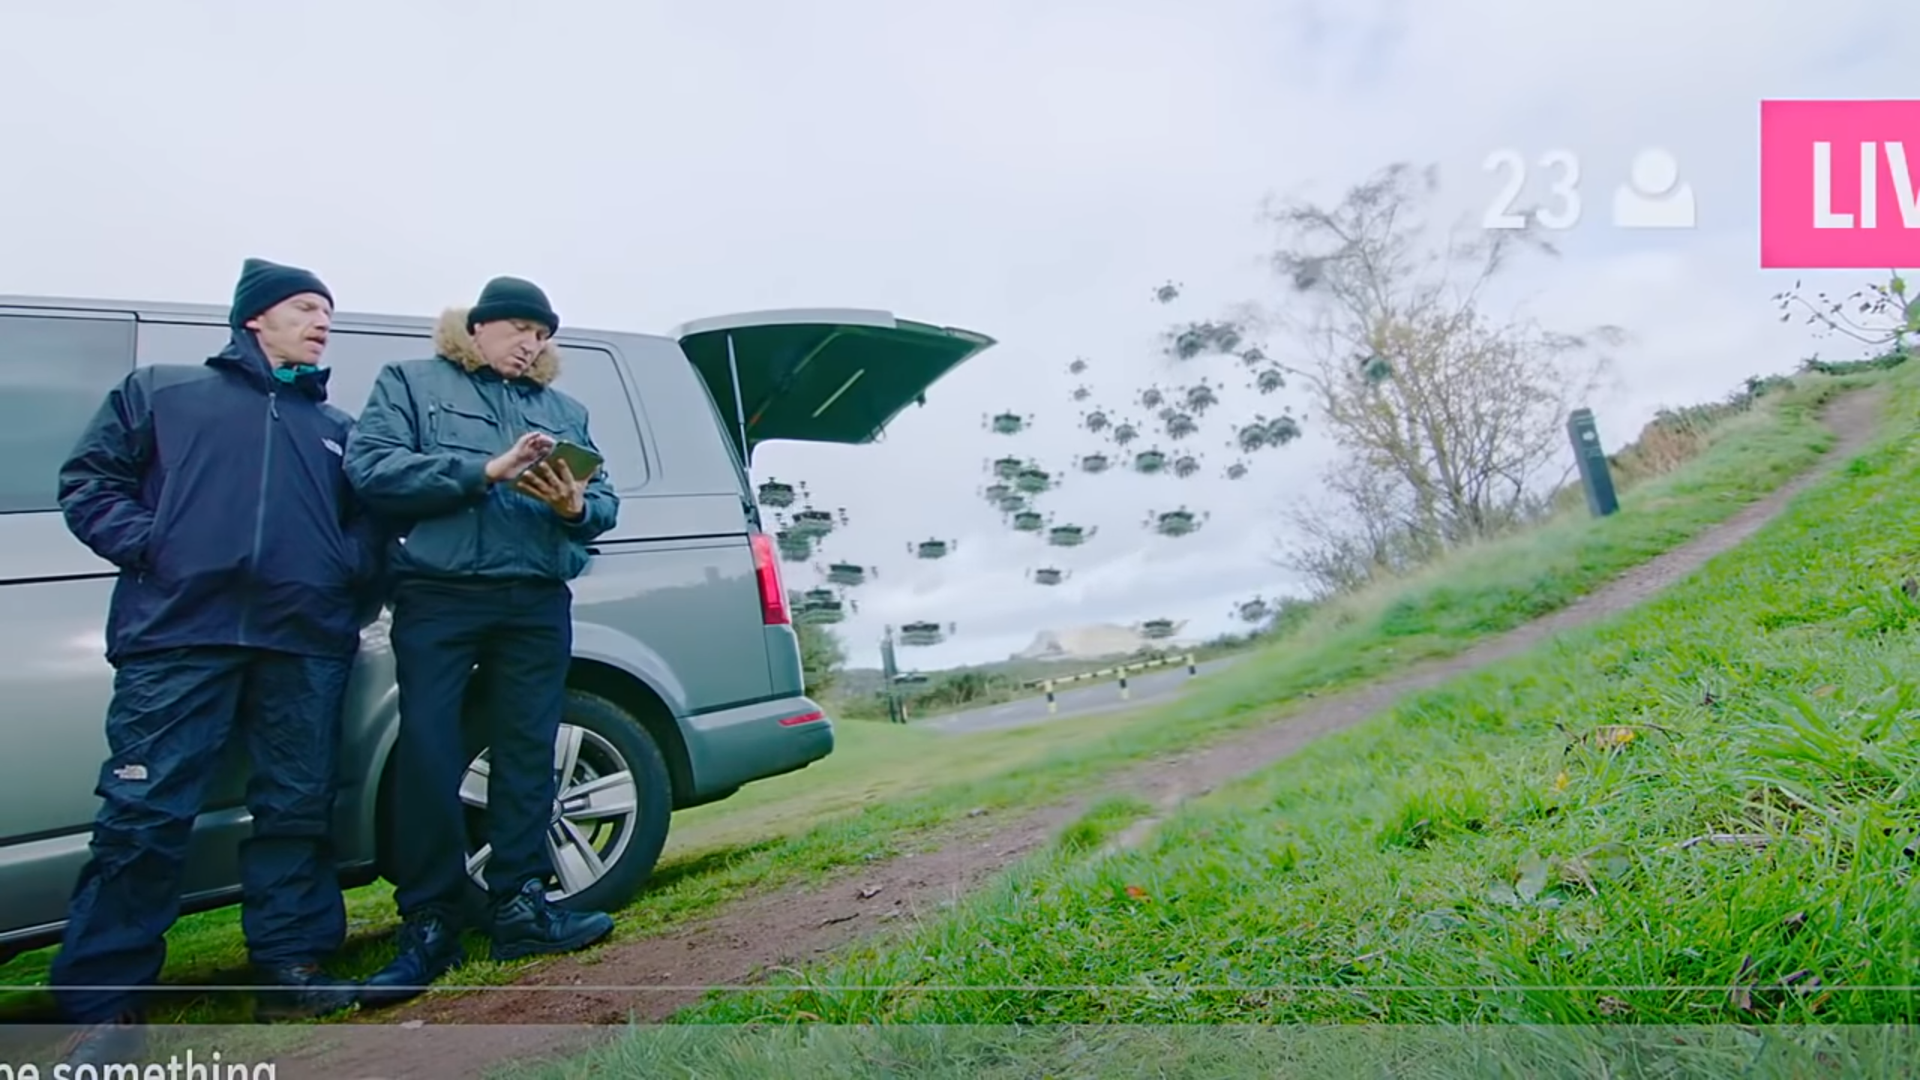
Advantages
Disadvantages
Mass production
Cost efficient
Depends on the intention of user

Slide 11
CONCLUSION
It is obvious that drone technology is an important part of the future of warfare and is set to become a big commercial industry.
The fact that drones capabilities pose a threat to the liberties of people around the globe is also apparent.
Legislating on drones now is of paramount importance because it sets the necessary limitations to protect rights as drones are used in the future

Slide 12
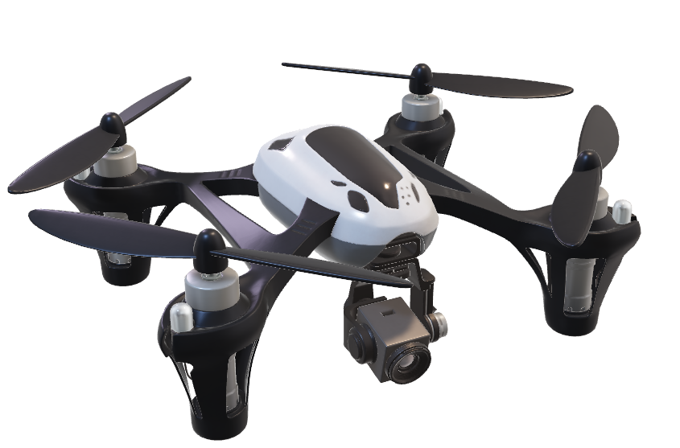
THANK YOU

